Slide 1
Example Problem: 2D IMPES and SS with Capillary Pressure, Gravity, Heterogeneities, and Anistotropy
April 11, 2017

Slide 2
Inputs
Reservoir Properties
L = 1200 ft
W = 600 ft
h = 200 ft
= varies (~0.26)
Kx = varies (~1800 mD)
Ky = 2*Kx
Kz = 2*Kx
c_{f} = 3.0 E-06 psi⁻¹
T= 100 °F
Water-Oil-Contact
WOC = Dref= 2309.5 ft
Po (WOC) = Pref =1003.5 psi
Fluid Properties
ρ_{stock tank oil} = 53 lb/ft³
ρ_{water phase}= 62.4 lb/ft³
SG_{gas phase} = 0.6
P_{b} = 502.505 psi
μ_{w,sat} = μ_{w,undersat} = 1.0 cp
μ_{o,sat} = 5 cp
μ_{o,undersat} P dependence= 0.001 cp/psi
μ_{o} (P) = μ_{o,sat} + μ_{o,undersat} P dependence * (P- P_{b})
c_{w} = 2.0 E-06 psi⁻¹
c_{o} = 5.0 E-06 psi⁻¹
B_{w,ref} = 1
P_{ref}= 1000 psi
B_{w,} (P)= B_{w} (P_{ref})[1- C_{w} (P- P_{ref})]
B_{o,sat} = 1.5;
B_{o,undersat} (P)= B_{o} (P_{b}) [1- C_{o} (P- P_{b})]
R_{s}(P_{b})= 90.7388 scf/STB
Well Properties
Q_inj = 3000 bbls/day
(Water only)
Q_prod = 2000 bbls/day
Q_prod2 = 800 psi (BHP)
r_{w} = 0.5 feet
s = 0
Initial Conditions
Po_init = varies
Pw_init = varies
Sw_init = varies
Numerical Properties
NX = 3
NY = 3
Δt = 0.01 days

Slide 3
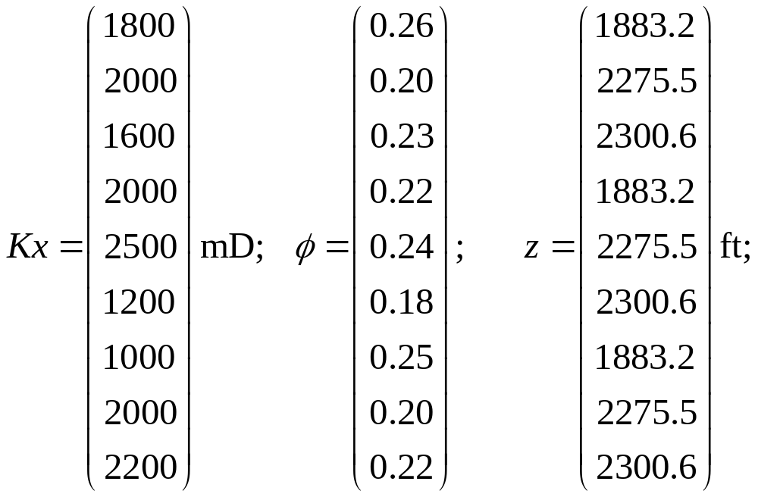
Block-Dependent Inputs

Slide 4
Simple 2D Geometry: 3 wells and no-flow boundaries
Δy=
300 ft
q_{prod2 (BHP)}
Δy=
200 ft
q_{inj}
Δy=
100 ft
q_{prod1}
Δx= 200 ft
Δx= 400 ft
Δx= 600 ft

Slide 5
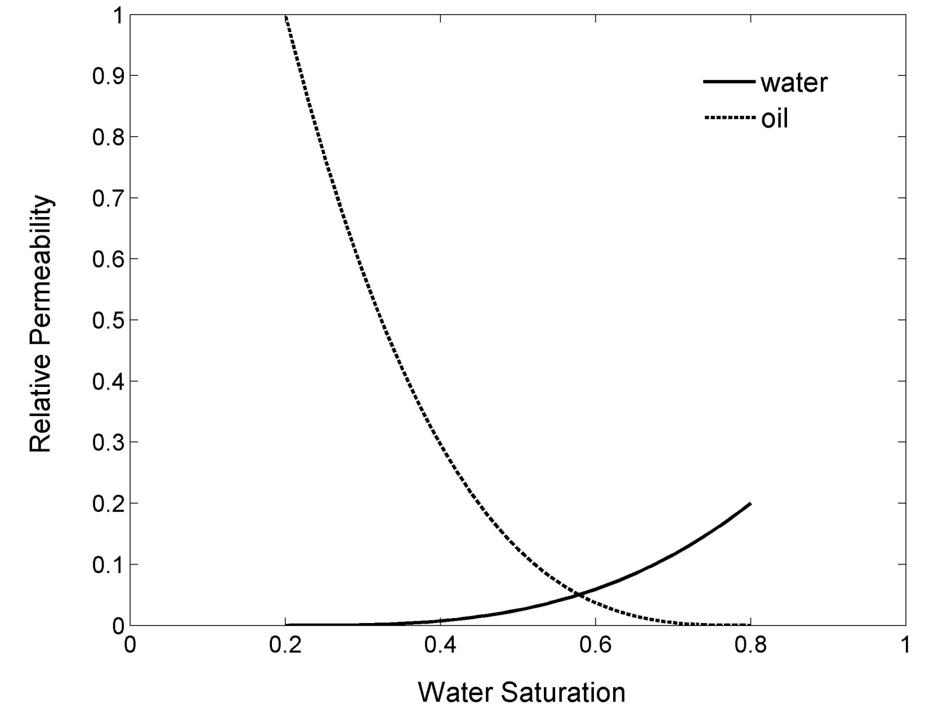
Relative Permeability Curves
k_{rw}= 0.2*S³ and k_{ro}= (1-S)³
S= (S_{w}-S_{wr})/(1-S_{wr}-S_{wi})
Take Swr=Swi=0.2
k_{rw}=rel perm of wetting phase k_{ro}=rel perm of nonwetting phase S_{w} = saturation S_{wr} = residual saturation S_{wi} = init saturation

Slide 6
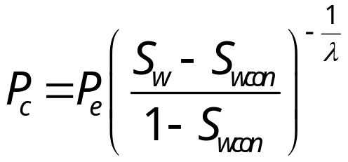
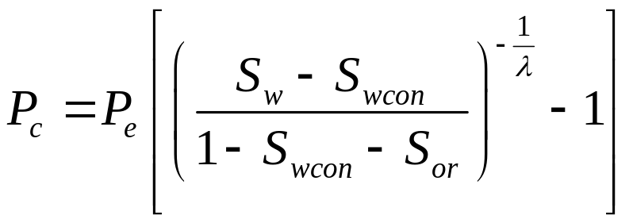
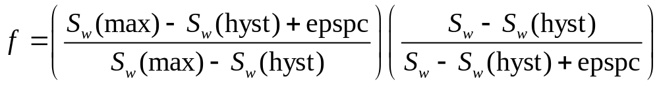
Capillary Pressure Curves
Drainage Curve
Imbibition Curve
Take P_{e}=3.5, S_{wcon} =0.2, S_{or} = 0.2, λ=2
Drainage-to-Imbibition Scanning Curve
Sw(hyst) = Sw when reversal occurred (Sw ↓ to Sw ↑)
Sw(max) = maximum attainable water saturation = 1-Soirw
epspc: dimensionless real number which determines the transition between the imbibition and drainage curves for oil-water capillary pressure (take epspc=1e-5)
k_{rw}=rel perm of wetting phase k_{ro}=rel perm of nonwetting phase S_{w} = saturation S_{wr} = residual saturation S_{wi} = init saturation

Slide 7
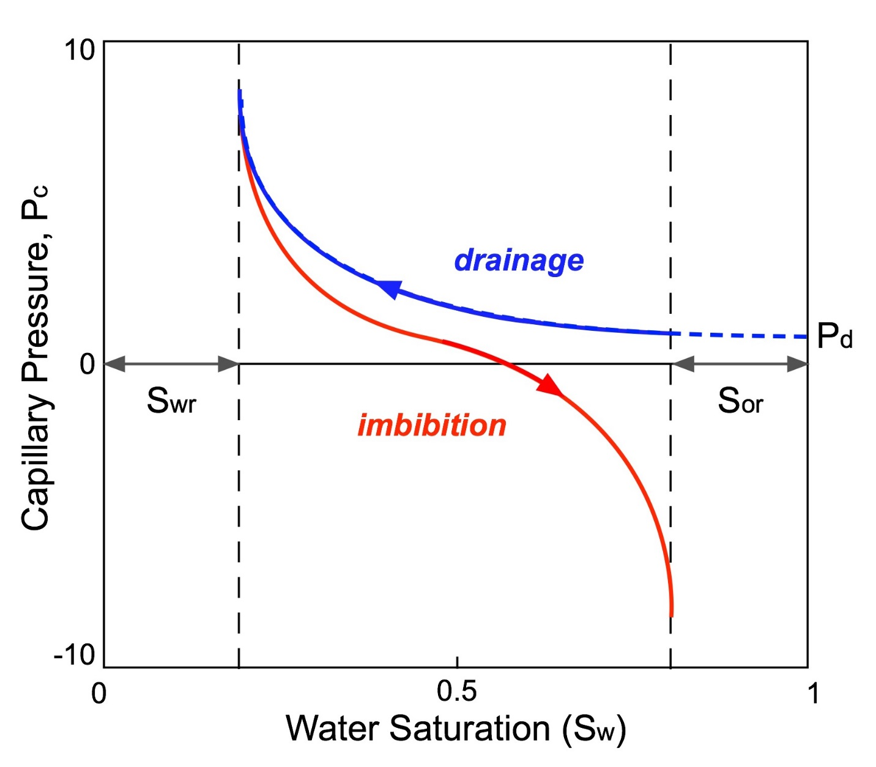
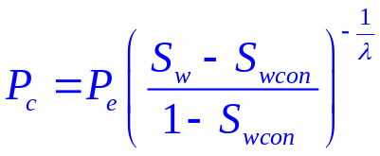
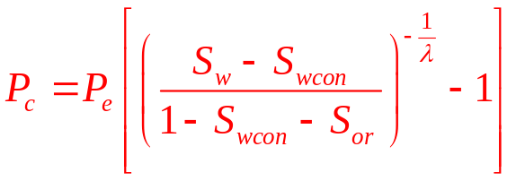
Capillary Pressure Curves

Slide 8

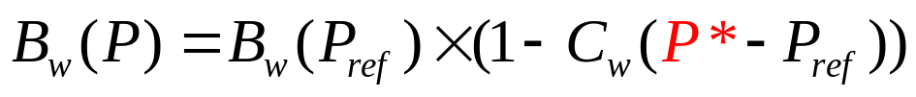
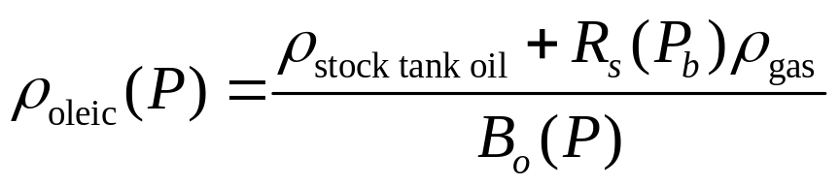
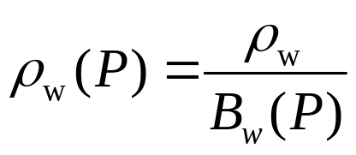
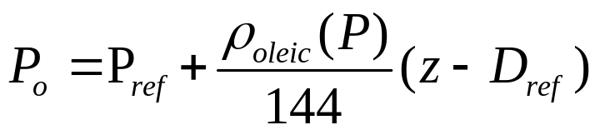
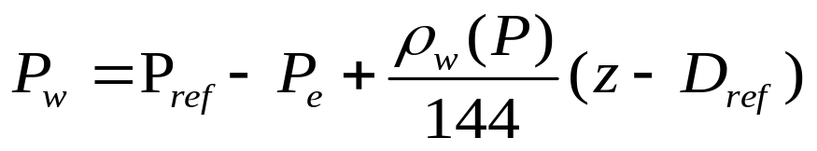
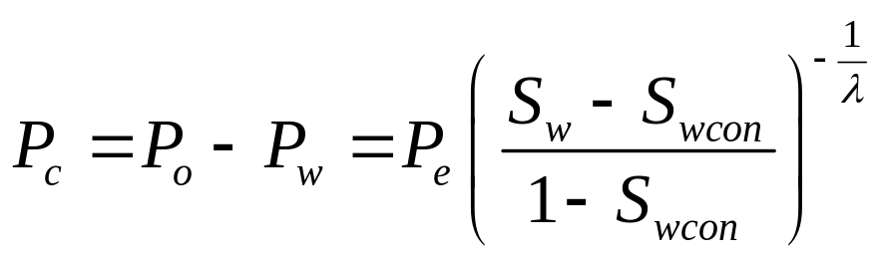
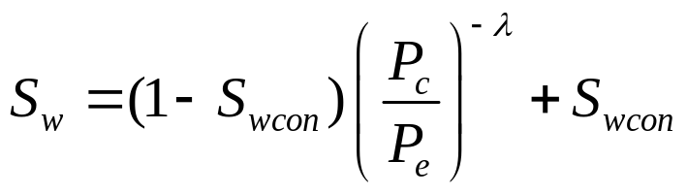
Calculate Initial Pressure and Saturation
*Pressure iteration (|P_guess-P_actual|<0. 01) required since pressure is not known to solve for FVF

Slide 9
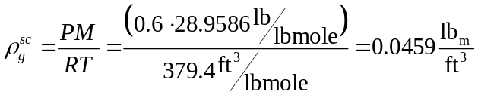
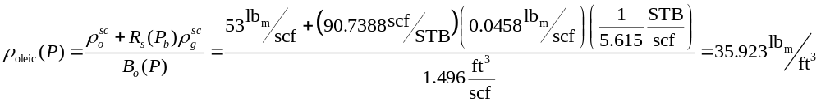

Oil Pressure: Block #1, 4, and 7 (z=1883.2 ft)
1. Estimate the FVF of oil at depth by guessing pressure at WOC
2. Calculate the density of the gas at standard conditions
3. Estimate density of oil at depth
4. Estimate pressure of oil at depth
5. Repeat steps #1-4 until convergence (|P_guess-P_actual|<0. 01)

Slide 10
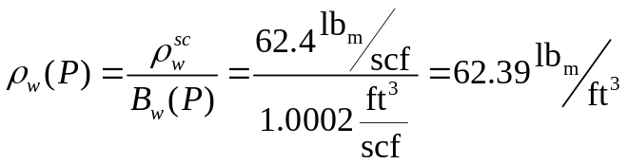

Water Pressure: Block #1, 4, and 7 (z=1883.2 ft)
1. Estimate the FVF of water at depth by guessing pressure at WOC
2. Estimate density of water at depth
3. Estimate pressure of water at depth
4. Repeat steps #1-4 until convergence (|P_guess-P_actual|<0. 01)

Slide 11
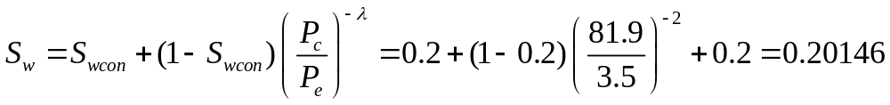
Calculate Pc and Sw: Block #1, 4, and 7 (z=1883.2 ft)
Compute capillary pressure in block
Back-calculate initial water saturation in block using drainage curve

Slide 12
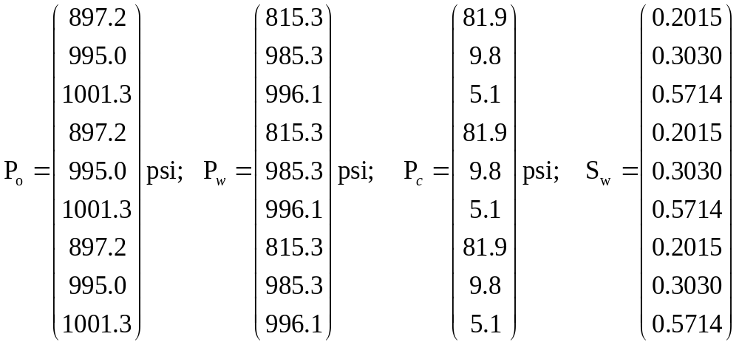
Initial Conditions for All Blocks

Slide 13
IMPES METHOD

Slide 14
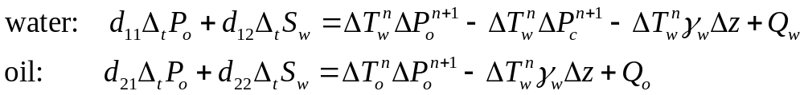
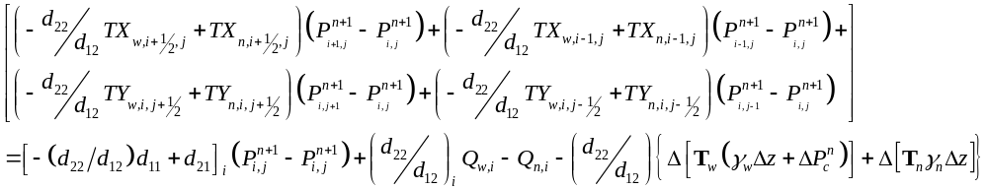
Pressure Equation for Each Block
Phase Mass Balances in short-hand
i,j
Overall Mass Balance found by adding water and oil balances
In-out of water + oil
Accumulation
Sources/sinks
Gravity and Cap Pressure
Expanding out the Transmissibility terms

Slide 15
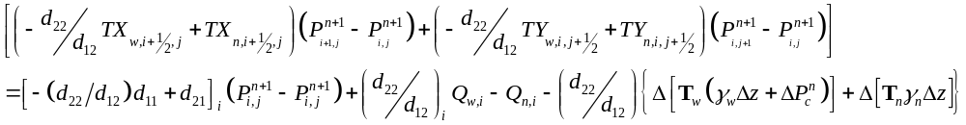
Block 1,1 (L=1)
q_{prod2}
q_{inj}
q_{prod1}
j
i
Gravity and capillary pressure present
Half transmissibilities are 0 on the left and bottom

Slide 16
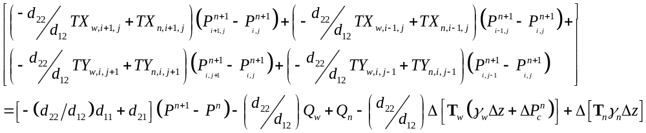
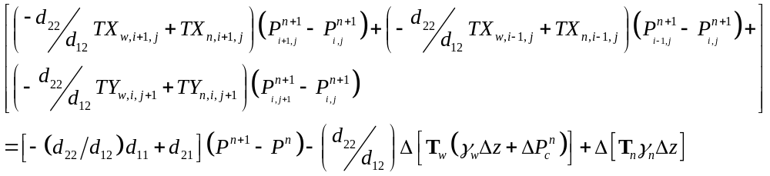
Block 2,1 (L=2)
q_{prod2}
q_{inj}
q_{prod1}
j
i
Gravity and capillary pressure present
Half transmissibilities are 0 on the bottom
No well

Slide 17
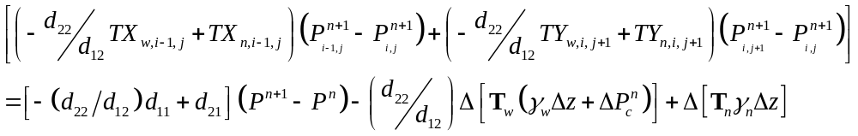
Block 3,1 (L=3)
q_{prod2}
q_{inj}
q_{prod1}
j
i
Gravity and capillary pressure present
Half transmissibilities are 0 on the bottom and right
No well

Slide 18

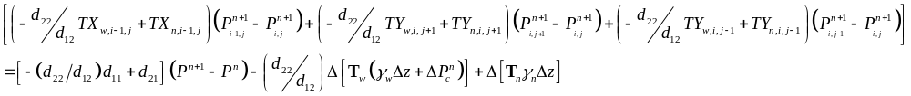
Block 1,2 (L=4)
q_{prod2}
q_{inj}
q_{prod1}
j
i
Gravity and capillary pressure present
Half transmissibilities are 0 on the left
No well

Slide 19
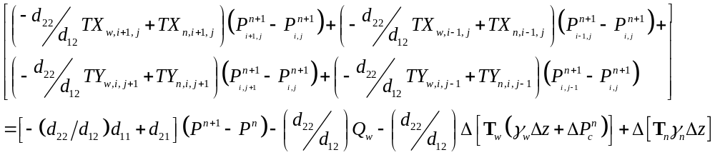
Block 2,2 (L=5)
q_{prod2}
q_{inj}
q_{prod1}
j
i
Gravity and capillary pressure present
No boundaries
Qn=0, because we inject wetting phase

Slide 20
Block 3,2 (L=6)
q_{prod2}
q_{inj}
q_{prod1}
j
i
Gravity and capillary pressure present
Half transmissibility on right is 0
No well

Slide 21
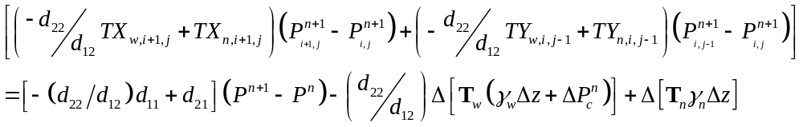
Block 1,3 (L=7)
q_{prod2}
q_{inj}
q_{prod1}
j
i
Gravity and capillary pressure present
Half transmissibility on left and top is 0
No well

Slide 22
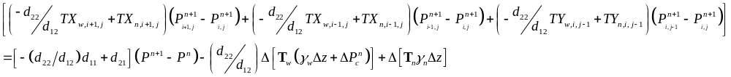
Block 2,3 (L=8)
q_{prod2}
q_{inj}
q_{prod1}
j
i
Gravity and capillary pressure present
Half transmissibility on top is 0
No well

Slide 23
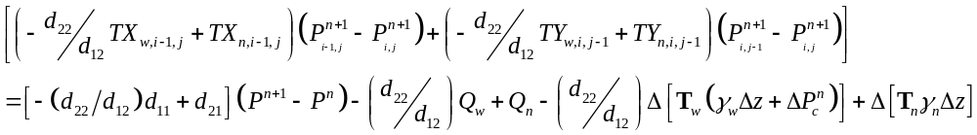
Block 3,3 (L=9)
q_{prod2}
q_{inj}
q_{prod1}
j
i
Gravity and capillary pressure present
Half transmissibility on top and right is 0

Slide 24
First Time Step

Slide 25
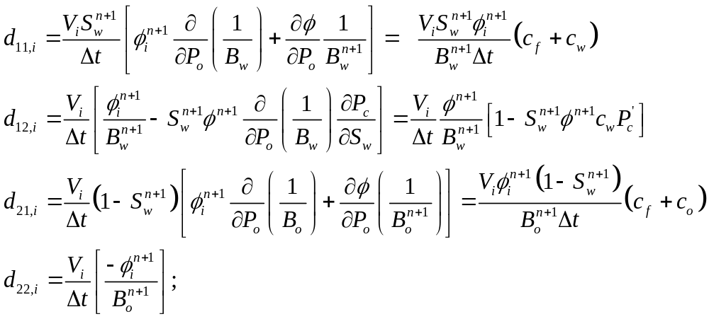
The “d” coefficients are given below
All of the “d’s” vary from block-to-block and also are functions of time because S_{w}, etc. vary with space and time.

Slide 26
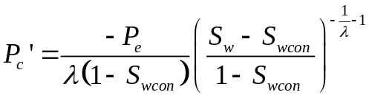
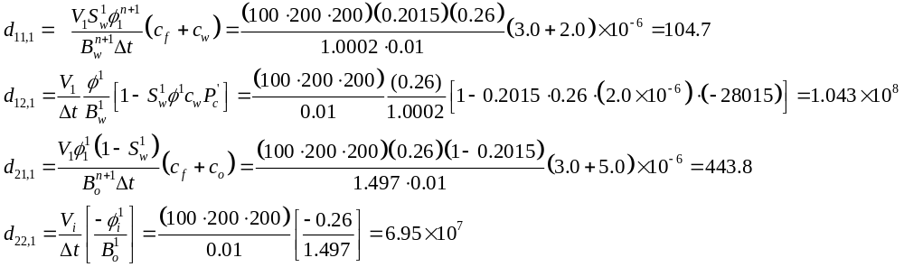
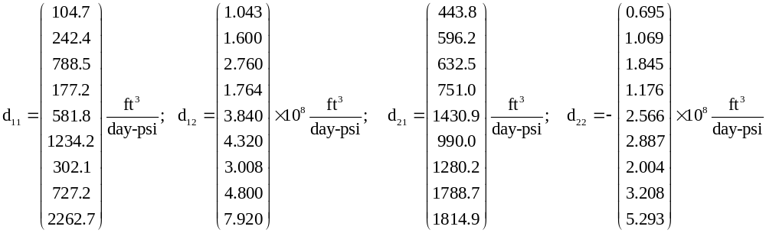
Each block does NOT have same properties (S_{w}=varying)
Calculate Pc’(use drainage curve now; scanning curve at later time steps)
Calculation for block #1
All blocks
Notes:
NEED TO UPDATE THESE NUMBERS

Slide 27
Transmissibility
Since gravity is present, we need to compare potential of each phase when using upwinding
Potential in all the blocks should be equal initially because the system is static (no flow) therefore upwinding is NOT possible
CMG uses fully implicit method (*AIMSET CON 1) for this simulation where rigorous iterative method is used to converge on a solution
  CMG solution at n+1 timestep uses T at n+1 timestep (potential is NOT the same)
MATLAB code uses IMPES method
  MATLAB solution at n+1 timestep uses T at n timestep (potential is the same )
  However, in our MATLAB solution, potential in blocks are slightly different (by less than 1 psi) due to numeric error; therefore, upwinding is possible
Even though this is not the proper approach, use of small timestep mostly eliminates discrepancy between the two different methods
Notes:
*default of CMG is AIMSET CON 0 (all blocks set to explicit except active well blocks, and during simulation, blocks may change to implicit as required), but experienced problems running it using the default method. Therefore, needed to run this simulation using the fully implicit method.

Slide 28
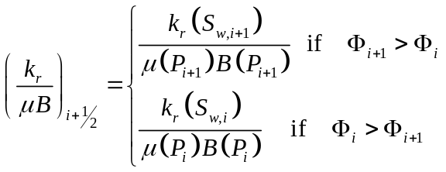
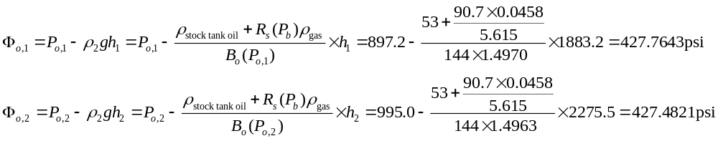
Oil Transmissibility (compare potential not pressure)
Permeability and grid sizes NOT uniform (use harmonic mean)
Saturation (and relative perm) NOT uniform - upwinding
Interblock transmissibility is given by,

Slide 29
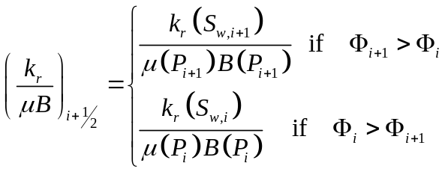
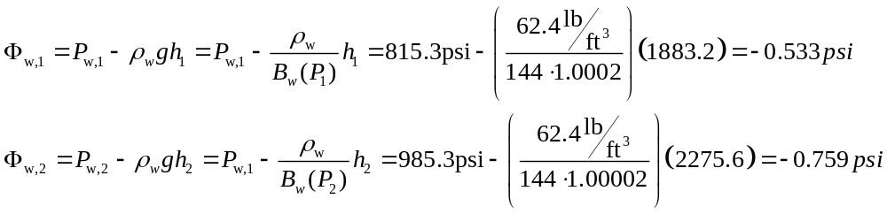
Water Transmissibility (compare potential not pressure)
Permeability and grid sizes NOT uniform (use harmonic mean)
Saturation (and relative perm) NOT uniform - upwinding
Interblock transmissibility is given by,

Slide 30
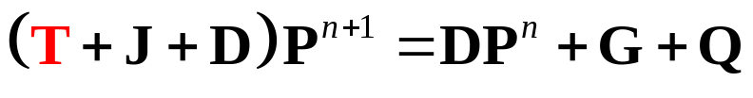
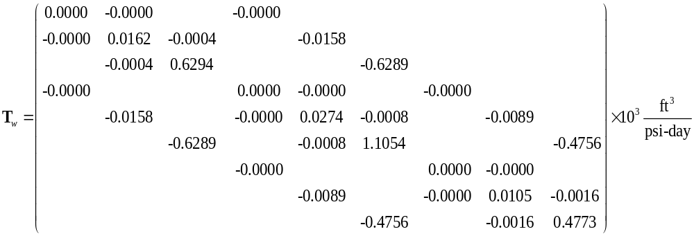
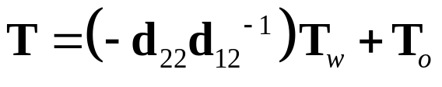
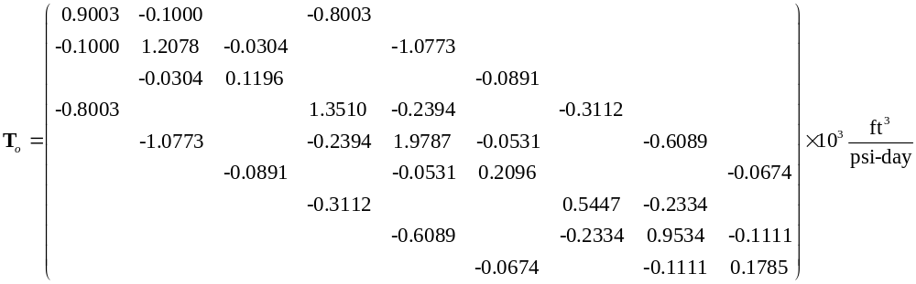
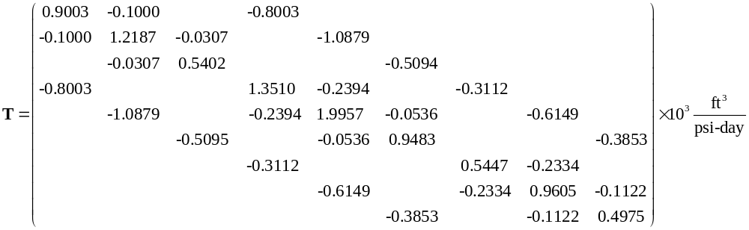
T matrix at First Time Step

Slide 31
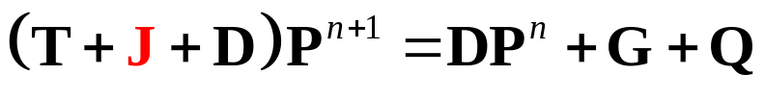
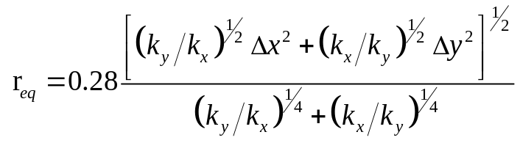
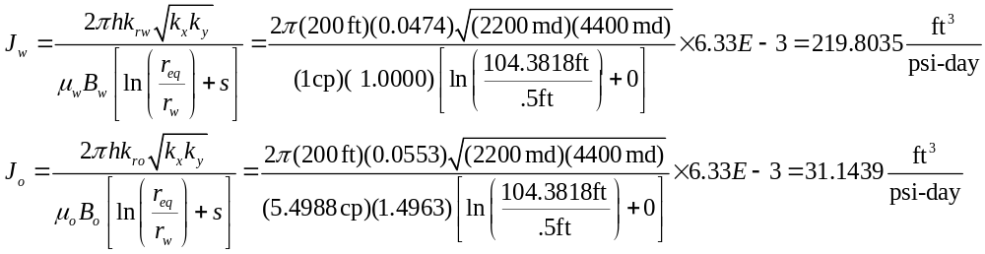
Productivity Indices
Peaceman Correction
Well #3 (in block #9) is the only constant BHP well
Compute the productivity index for each phase for well #3

Slide 32
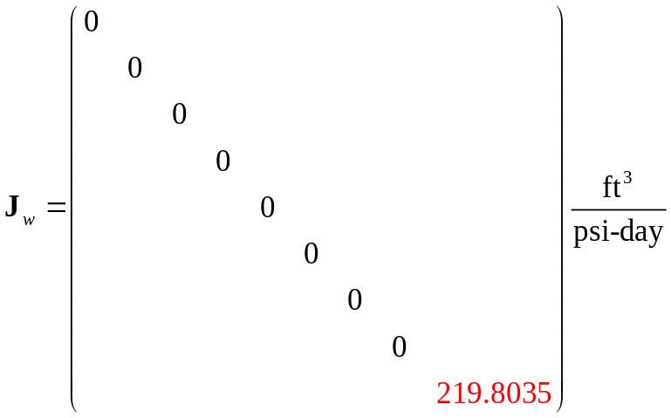
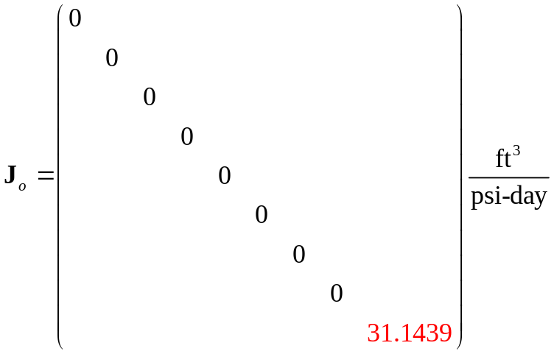

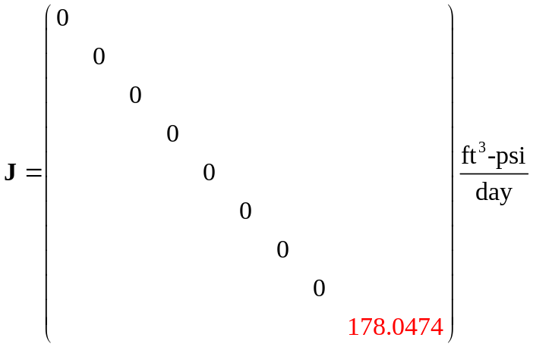
J matrix at First Time Step

Slide 33



D matrix at First Time Step

Slide 34



G vector at First Time Step
Initially on Drainage capillary pressure curve
Density of fluid need to be adjusted for pressure of block

Slide 35










Q matrix at First Time Step
Well #1 (in block #1) is constant producer (2000 STB/day); use fractional flow
Well #2 (in block #5) is constant injector (3000 STB/day) of only water
Well #3 (in block #9) is a constant BHP well

Slide 36



Solution at First Time Step

Slide 37


Update Saturations

Slide 38
Second Time Step

Slide 39



T matrix at First Time Step

Slide 40

Productivity Indices
Peaceman Correction
Well #3 (in block #9) is the only constant BHP well
Compute the productivity index for each phase for well #3

Slide 41






D Matrix at Second Time Step

Slide 42



Hysteresis Scanning Capillary Pressure Curve
Blocks in red are decreasing in water saturation (still draining) and Pc drainage curve is used
Blocks in green are increasing in water saturation and a weighted average of drainage/imbibition curves are used
Sw(hyst) = Sw when reversal occurred (Sw ↓ to Sw ↑)
Sw(max) = maximum attainable water saturation = 1-Soirw
epspc: dimensionless real number which determines the transition between the imbibition and drainage curves for oil-water capillary pressure (take epspc=1e-5)

Slide 43




Hysteresis Scanning Capillary Pressure Curve
Consider block #1 which requires a scanning curve. Compute f
Consider block #1 which requires a scanning curve

Slide 44

G matrix at Second Time Step
Either Drainage-to-Imbibition scanning curve or drainage curve
Density of fluid need to be adjusted for pressure of block

Slide 45


Solution at Second Time Step

Slide 46

Update Saturations

Slide 47










IMPES Summary
“Hand” (Matlab) Solution
t=0 days
t=0.1 days
t=0.2 days
t=0.3 days
t=500 days
CMG Solution
t=0 days
t=0.1 days
t=0.2 days
t=0.3 days
t=500 days

